Slide 1
Take a seat and without talking, write down the following standards: SS7G1.a – Locate on a world and regional political-physical map: the Sahara, Sahel, savanna, tropical rain forest, Congo River, Niger River, Lake Tanganyika, Lake Victoria, Atlas Mountains, and Kalahari Desert. SS7G1.b – Locate on a world and regional political-physical map the countries of: Democratic Republic of Congo (Zaire), Egypt, Kenya, Nigeria, South Africa, and Sudan.

Slide 2
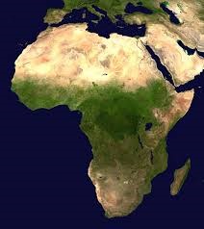
Bell-Ringer
In your notebook, complete the following:
Write down at least 3 things you know about Africa and at least 5 things you would like to know more about Africa.

Slide 3
KWL Chart
K W L

Slide 4
Africa Intro Video
https://www.youtube.com/watch?v=Acs5Ic2RFuA
What images did you see? What geographical regions did you see in the video?

Slide 5
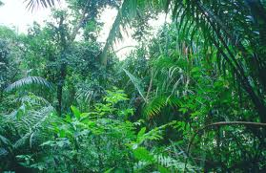
Geographic Region?

Slide 6
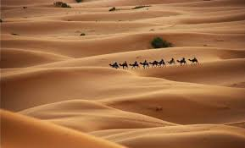
Geographic Region?

Slide 7
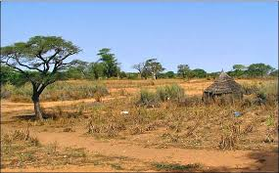
Geographic Region?

Slide 8
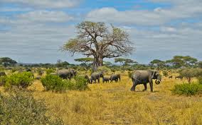
Geographic Region?

Slide 9
Sheppard Software
http://www.sheppardsoftware.com/African_Geography.htm
Countries Level L – Democratic Republic of Congo (Zaire), Egypt, Kenya, Nigeria, South Africa, Sudan, and South Sudan.
Georegions L and G – the Sahara, Sahel, Atlas Mountains, and Kalahari Desert.
Rivers L – Congo River and Niger River
Oceans L – Lake Tanganyika and Lake Victoria

Slide 10
Work Session
Using your geography textbooks, agenda, and Sheppard Software, complete the following:
1.) On one map, locate and color the countries: Democratic Republic of Congo (Zaire), Egypt, Kenya, Nigeria, South Africa, Sudan, and South Sudan.
2.) On the other map, locate and color the features: the Sahara, Sahel, savanna, tropical rain forest, Congo River, Niger River, Nile River, Lake Tanganyika, Lake Victoria, Atlas Mountains, and Kalahari Desert.

Slide 11
Geographic Regions Help
http://www.purposegames.com/game/a40bea063e
Using the game, fill in any geographical regions you did not complete on your map!

Slide 12
Closing
Were there any countries or features that you could not find? What should you do to find those locations?
It is important that you find all of the countries and features I told you to find because there will be a QUIZ.
http://www.sheppardsoftware.com/African_Geography.htm

